Slide 1
Human genome structure, function and clinical considerations
Phuc Loi Luu, PhD
Loi.lp@pacificinformatics.com.vn
05/08/2023

Slide 2
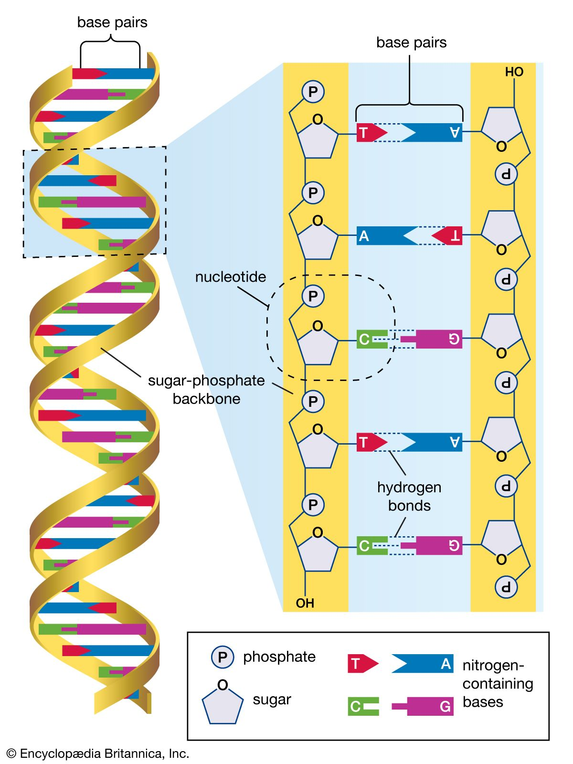
Content
DNA structure
Human genome project (HGP)
Human genome in a nutshell
Human reference genome
Genome components
Genome 3D structure
Gene structure
Gene Annotation
Gene conservation and mappability
GEO NCBI
ENA Browser EBI

Slide 3
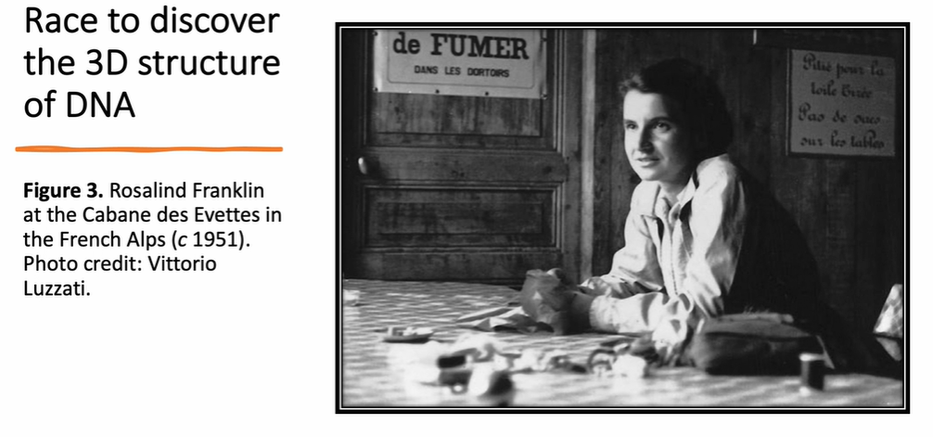
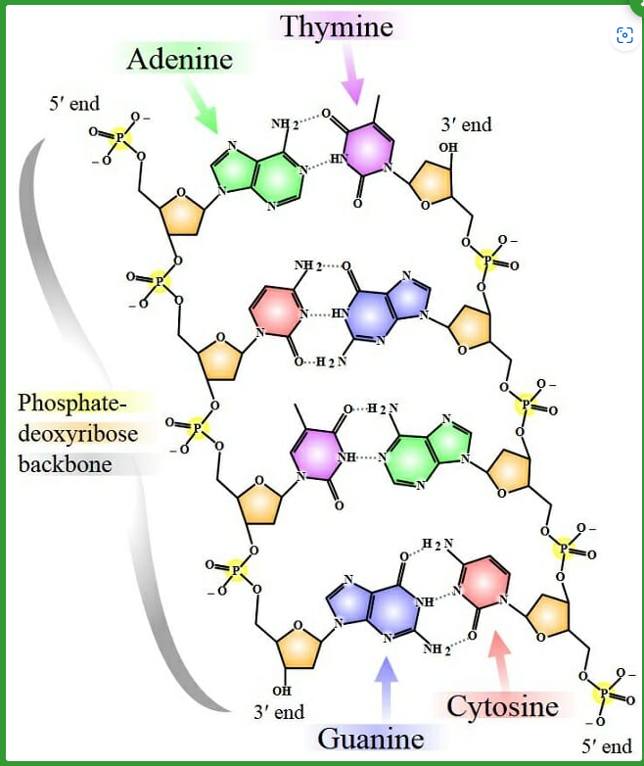
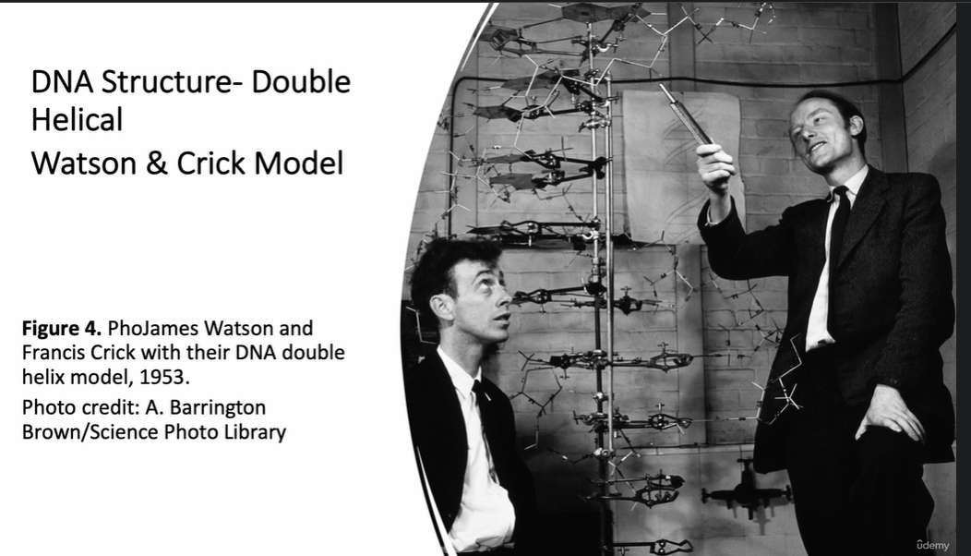
CpG
DNA - Definition, Function, Structure and Discovery | Biology Dictionary

Slide 4
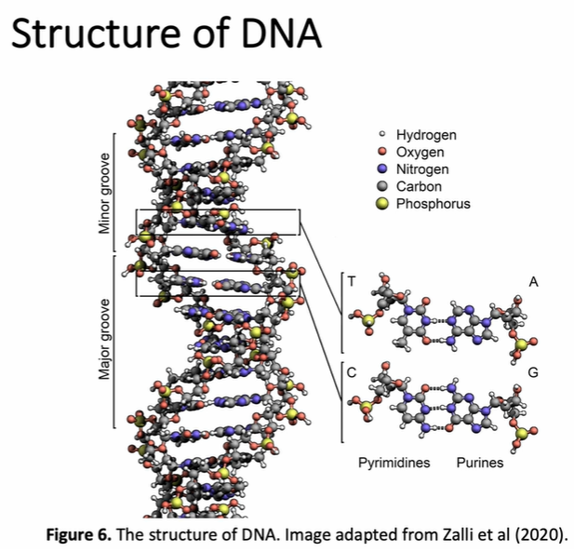
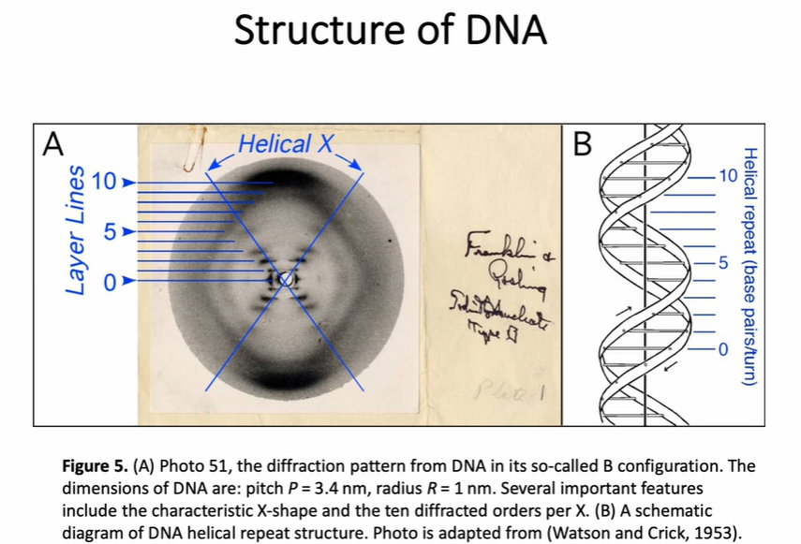

Slide 5
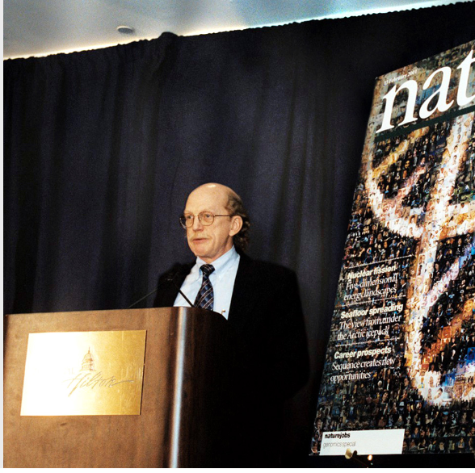
Human genome project (HGP)
Was large, well-organized, and highly collaborative international effort that generated the first sequence of the human genome and that of several additional well-studied organisms.
Carried out from 1990–2003, it was one of the most ambitious and important scientific endeavors in human history.
Human Genome Project Timeline

Slide 6
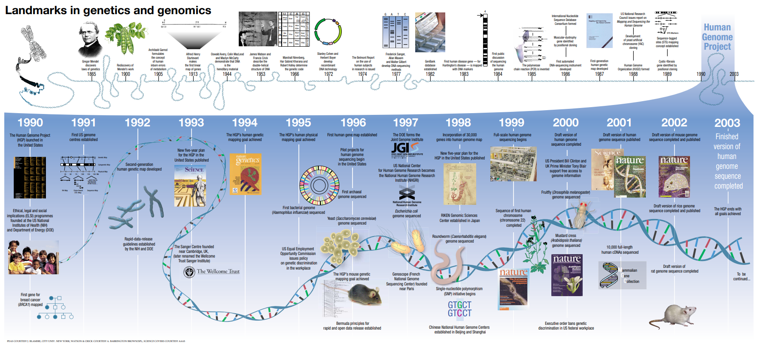
Landmarks in genetics and genomics (genome.gov)

Slide 7
Human genome project (HGP)
The sequence of the human genome generated by the Human Genome Project was not from a single person.
Rather, it reflects a patchwork from multiple people whose identities were intentionally made anonymous to protect their privacy.
The project researchers used a thoughtful process to recruit volunteers, acquire their informed consent, and collect their blood samples.
Most of the human genome sequence generated by the Human Genome Project came from blood donors in Buffalo, New York; specifically, 93% from 11 donors, and 7% from one donor.

Slide 8
Human genome project (HGP)
The Human Genome Project could not have been completed as quickly and effectively without the dedicated participation of an international consortium of thousands of researchers.
In the United States, the researchers were funded by the Department of Energy and the National Institutes of Health, which created the Office for Human Genome Research in 1988 (later renamed the National Center for Human Genome Research in 1990 and then the National Human Genome Research Institute in 1997).
The sequencing of the human genome involved researchers from 20 separate universities and research centers across the United States, United Kingdom, France, Germany, Japan and China.
The groups in these countries became known as the International Human Genome Sequencing Consortium.
Human Genome Project Fact Sheet

Slide 9
Human genome project (HGP)
In June 2000, the International Human Genome Sequencing Consortium announced that it had produced a draft human genome sequence that accounted for 90% of the human genome. The draft sequence contained more than 150,000 areas where the DNA sequence was unknown because it could not be determined accurately (known as gaps).
In April 2003, the consortium announced that it had generated an essentially complete human genome sequence, which was significantly improved from the draft sequence. Specifically, it accounted for 92% of the human genome and less than 400 gaps; it was also more accurate.
On March 31, 2022, the Telomere-to-Telomere (T2T) consortium announced that had filled in the remaining gaps and produced the first truly complete human genome sequence.
Human Genome Project Fact Sheet

Slide 10
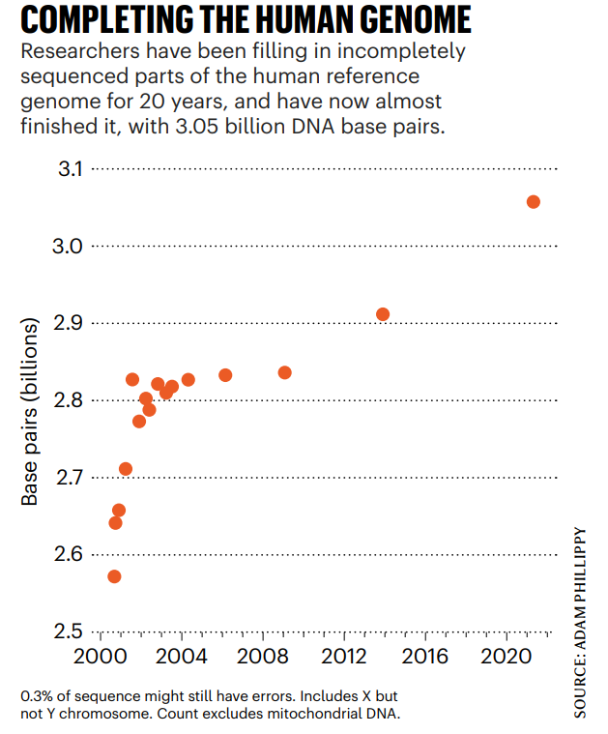


Slide 11
(35) Lessons from the Human Genome Project - YouTube
https://www.youtube.com/watch?v=qOW5e4BgEa4

Slide 12
How did the Human Genome Project affect biological research in general?
Discuss and give an example!

Slide 13
How did the Human Genome Project affect medical research and clinical application in general?
Discuss and give an example!

Slide 14
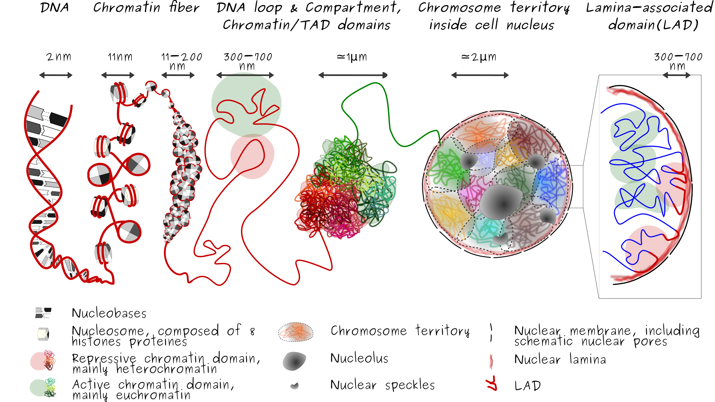
index_3DOrgGenome_SquareShape.png (2523×1422) (abrunet.com)

Slide 15
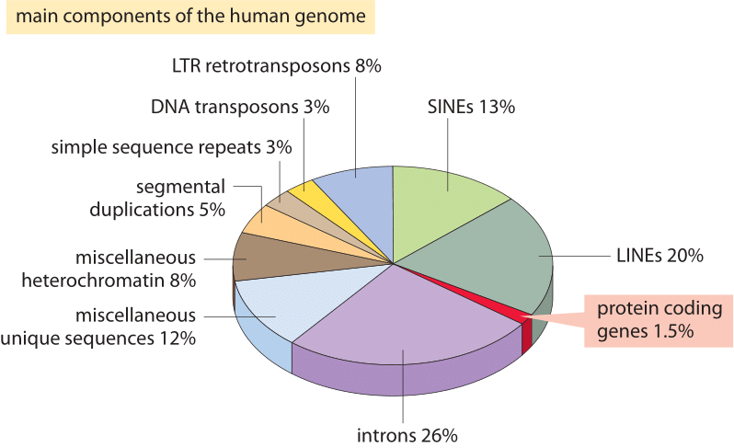
Genome components
» How many genes are in a genome? (bionumbers.org)

Slide 16
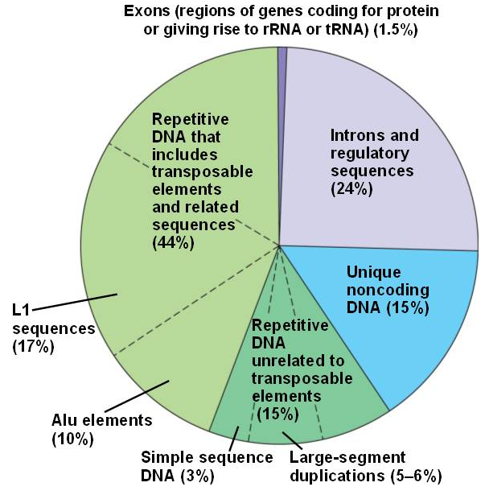
Genome components
The human genome contains less than 2% coding exons within genes.
The remaining DNA consist of:
introns and regulatory sequences such as enhancers
unique noncoding DNA contains many pseudogenes (genes that have accumulated mutations and became nonfunctional)
repetitive DNA are sequences that are repeated many times; much of these are
transposable elements that can "jump" between chromosomes, leading to transpositions.
human_genome.html 21_07HumanDNATypes-L.jpg (nicerweb.com)

Slide 17
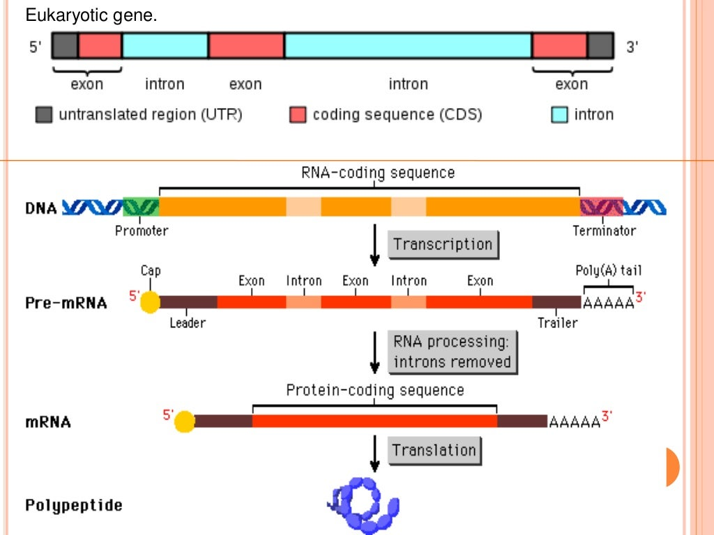
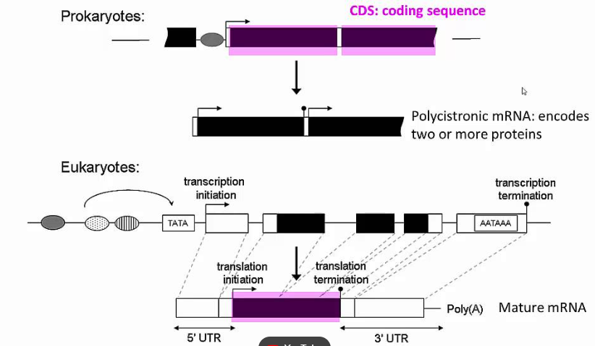
Gene structure

Slide 18
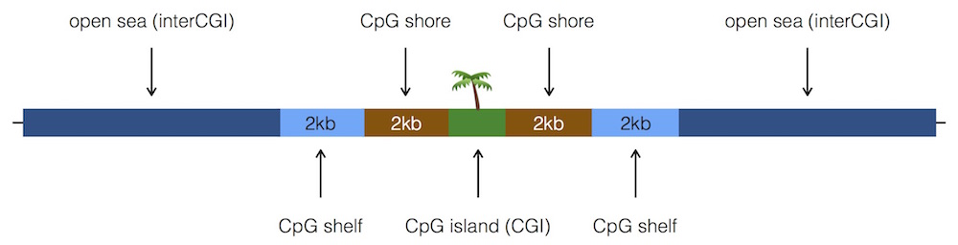
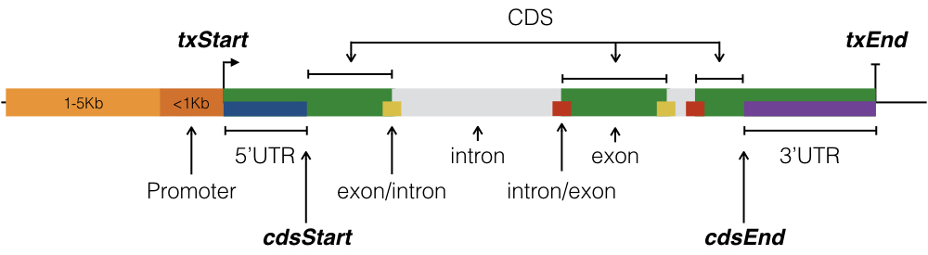
Gene structure
https://www.bioconductor.org/packages/devel/bioc/vignettes/annotatr/inst/doc/annotatr-vignette.html

Slide 19
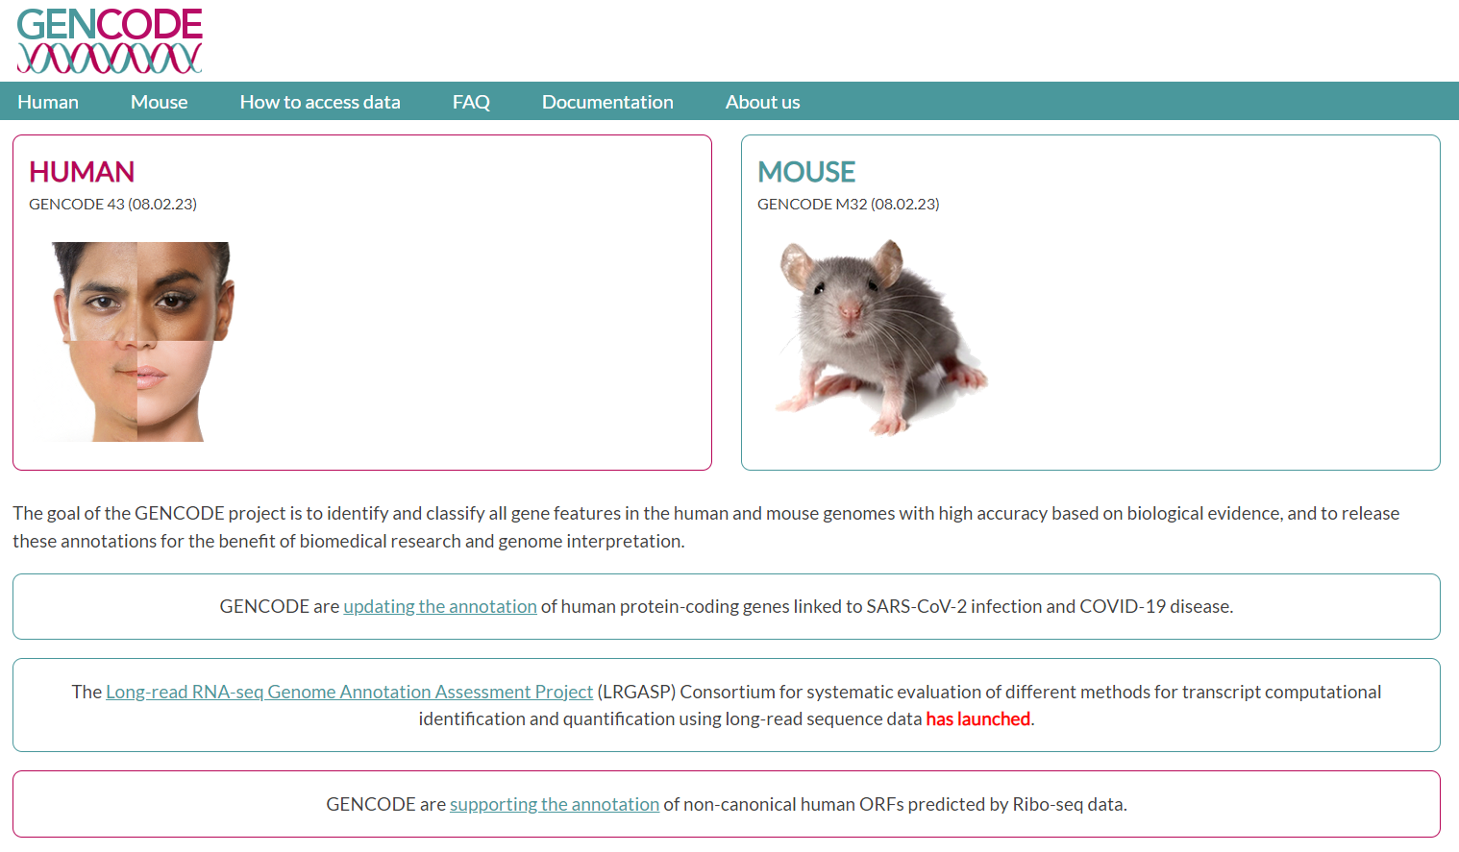
Understanding Gene Annotation through GENCODE (https://www.gencodegenes.org/)

Slide 20
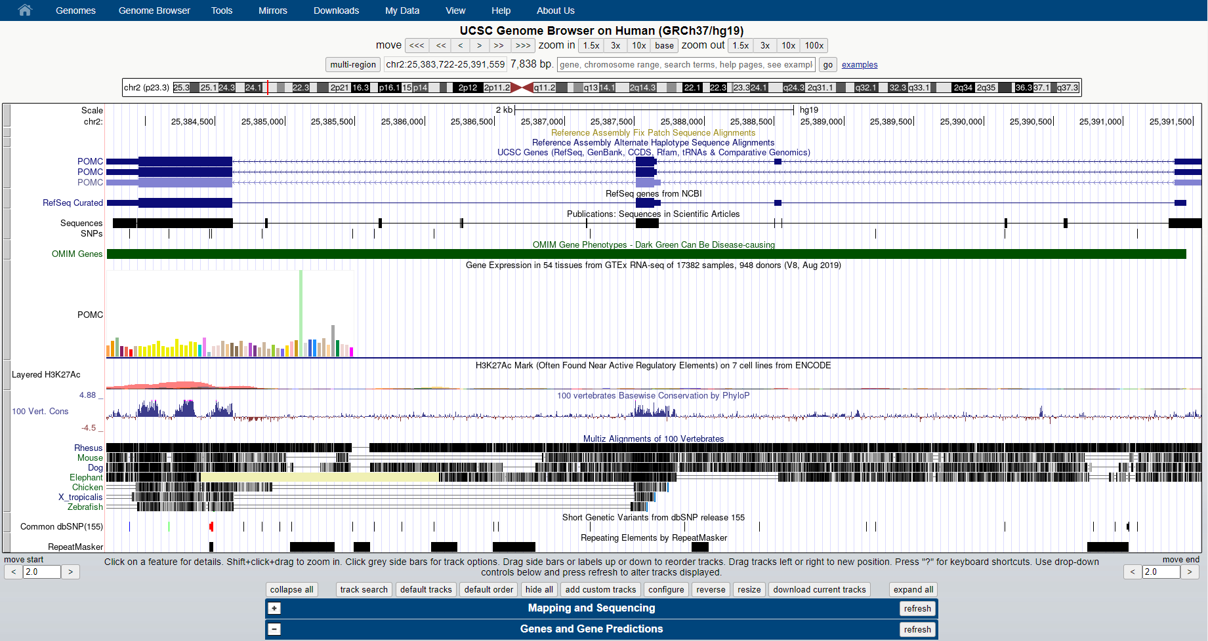
Understanding Human reference genome through the UCSC Genome Browser (https://genome.ucsc.edu/)

Slide 21
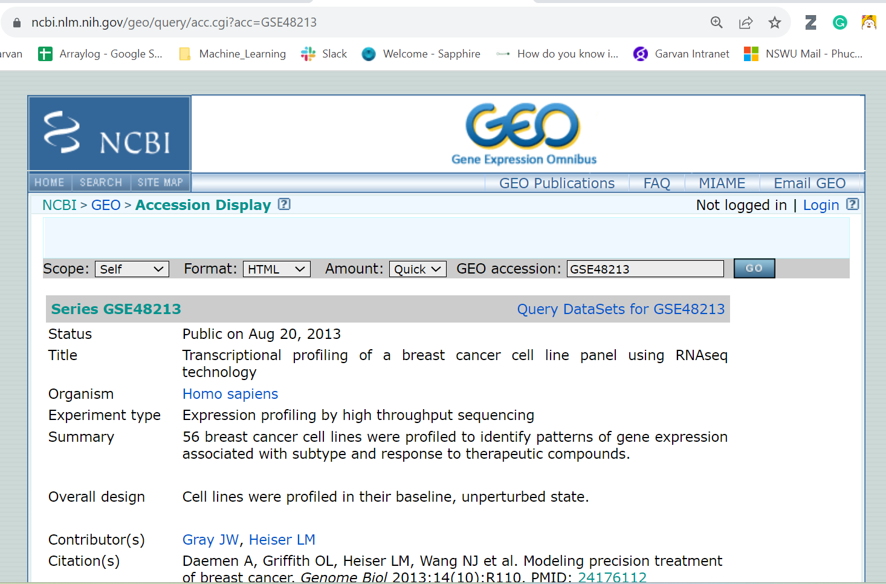
GEO NCBI (https://www.ncbi.nlm.nih.gov/geo/)

Slide 22
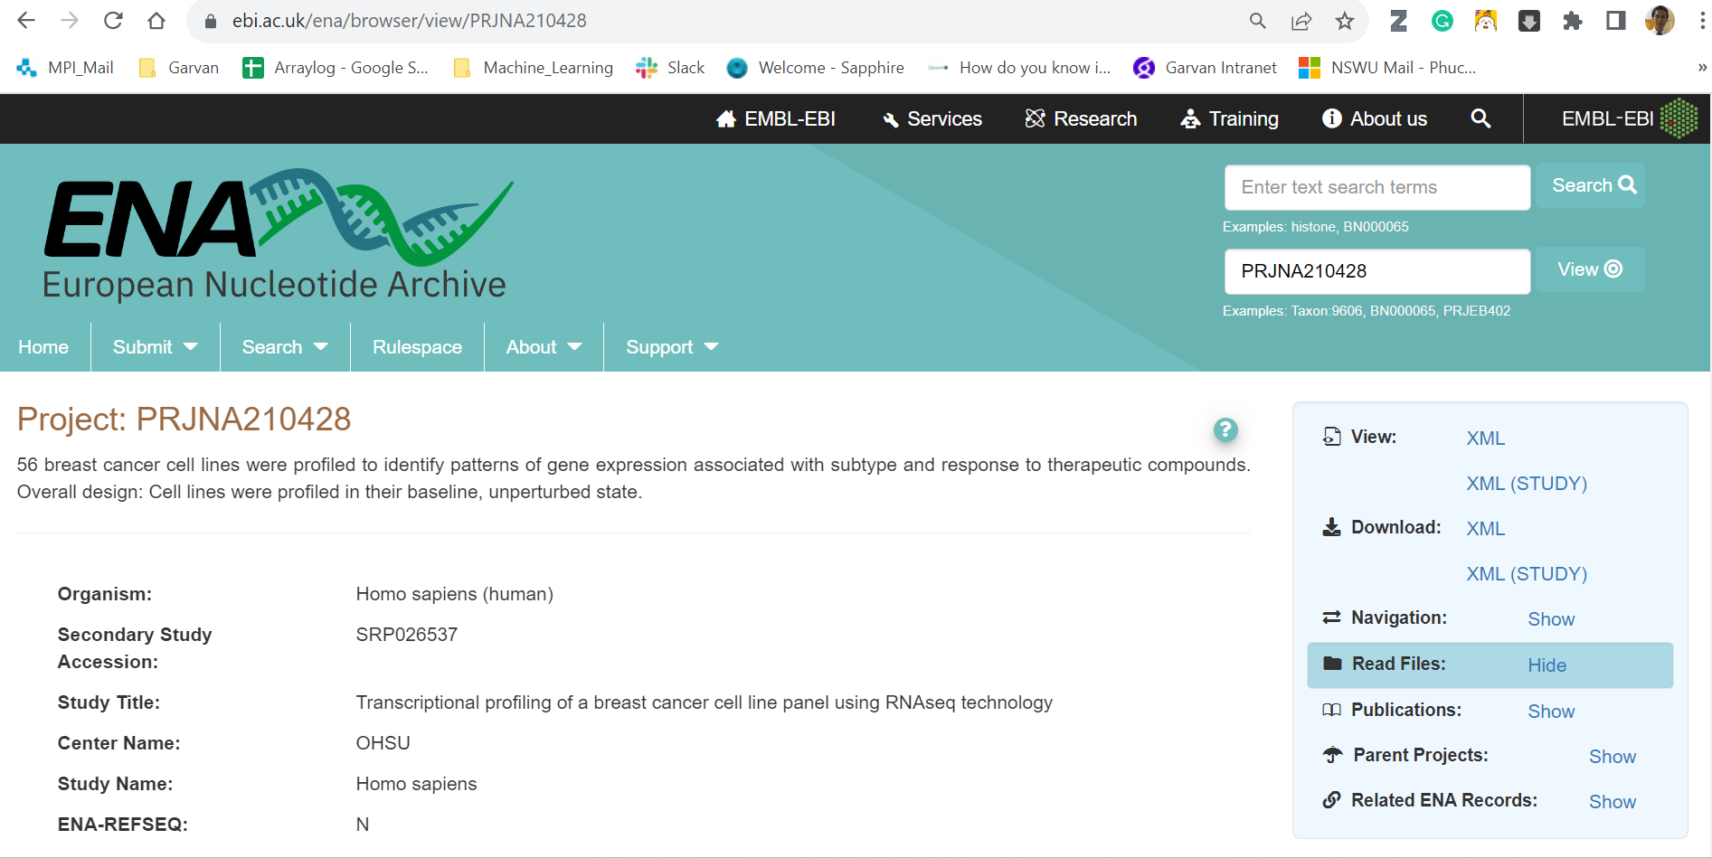
ENA (https://www.ebi.ac.uk/ena/browser/home)

